Slide 1


OmniDetect
Applied Artificial Intelligence Project- Real-Time Vision with YOLO
Ibrahim Abou Zahr- Mohamad El Mawed

Slide 2

Introduction
OmniDetect is a real-time object detection application that leverages YOLOv8 and Streamlit to identify and classify objects in images and videos

Slide 3
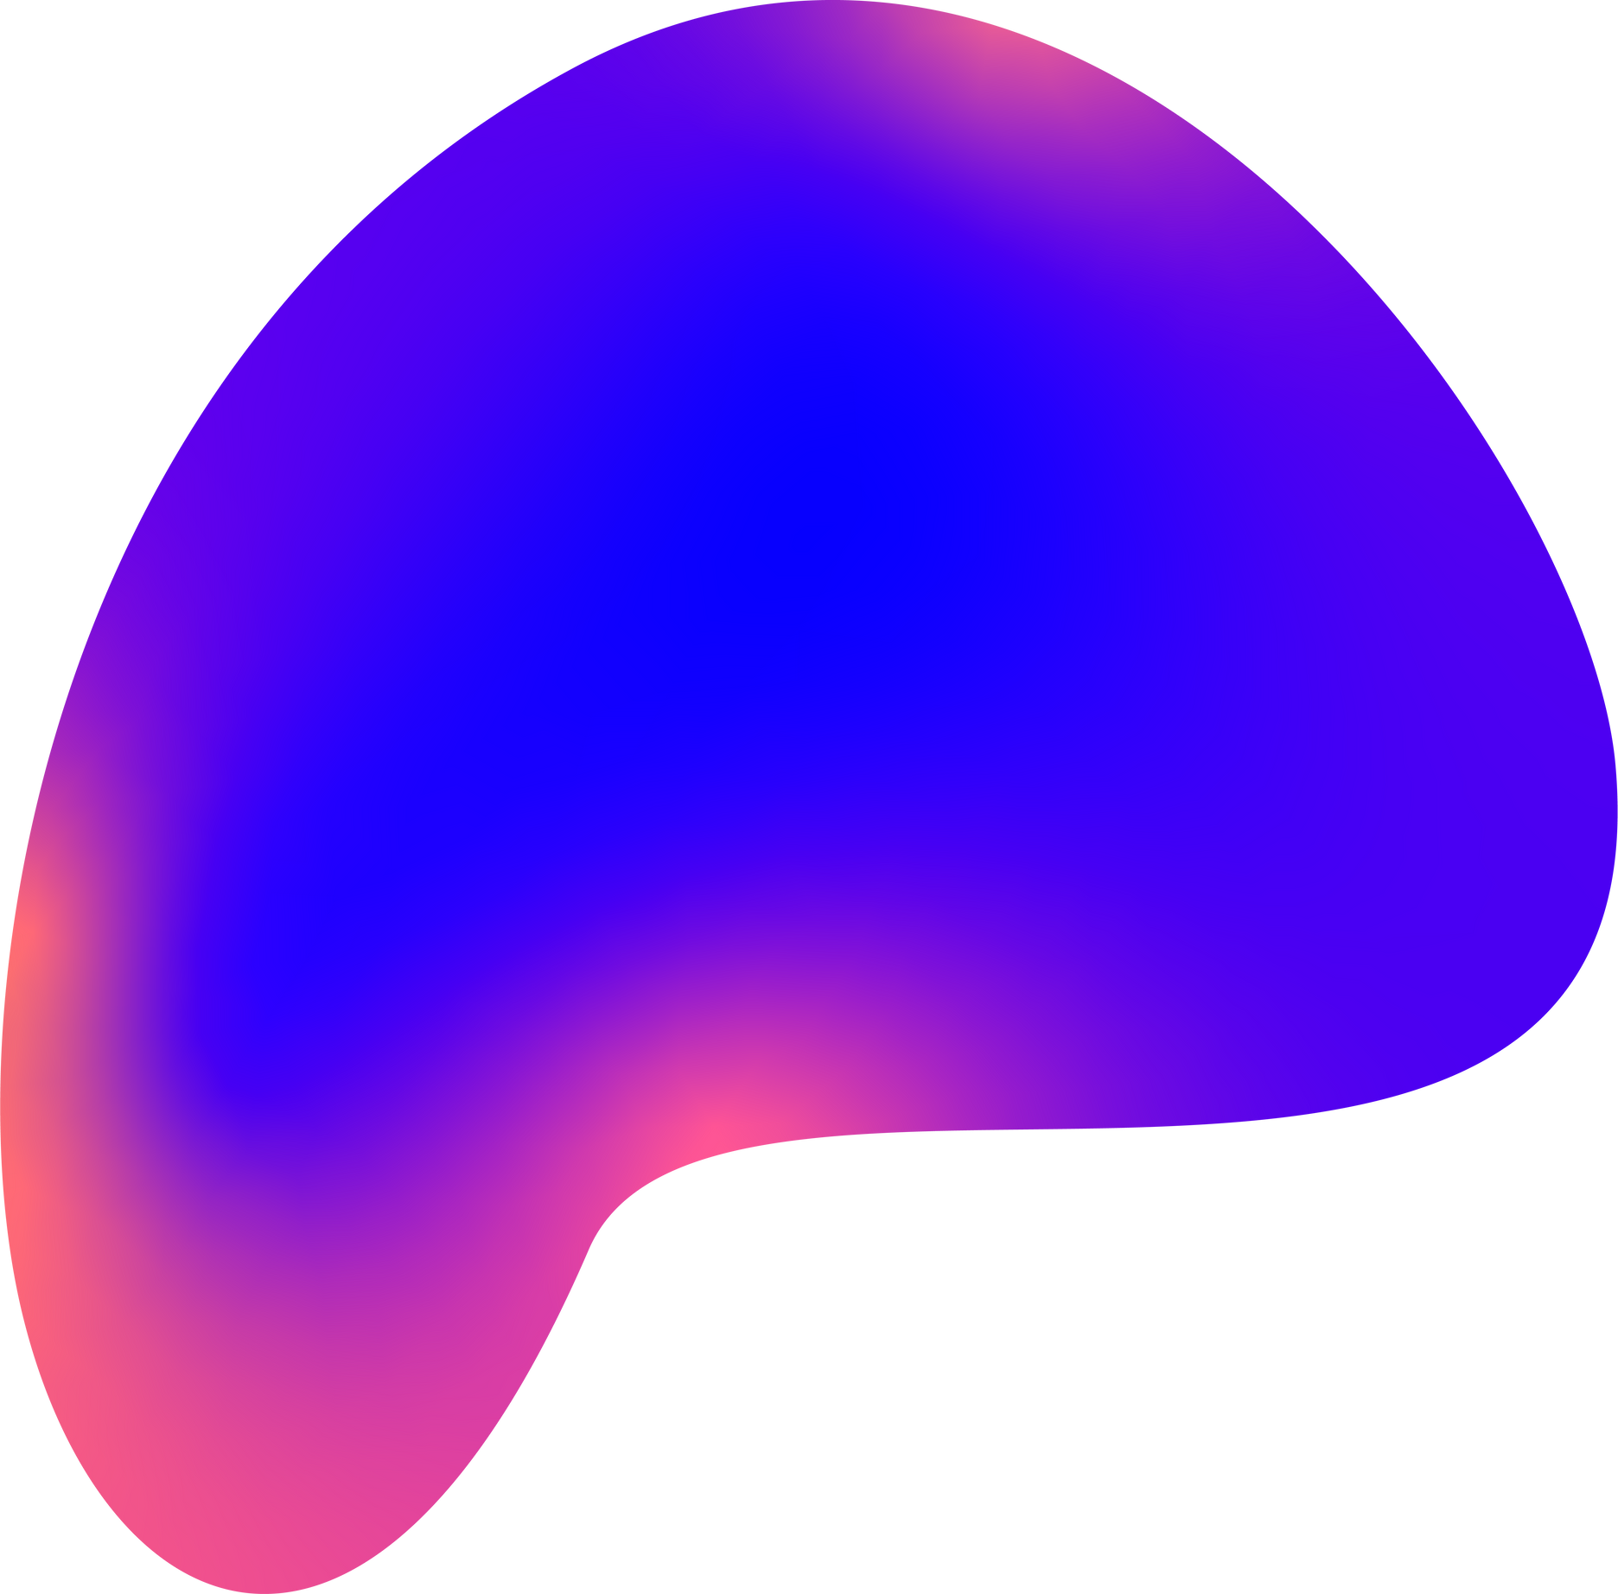
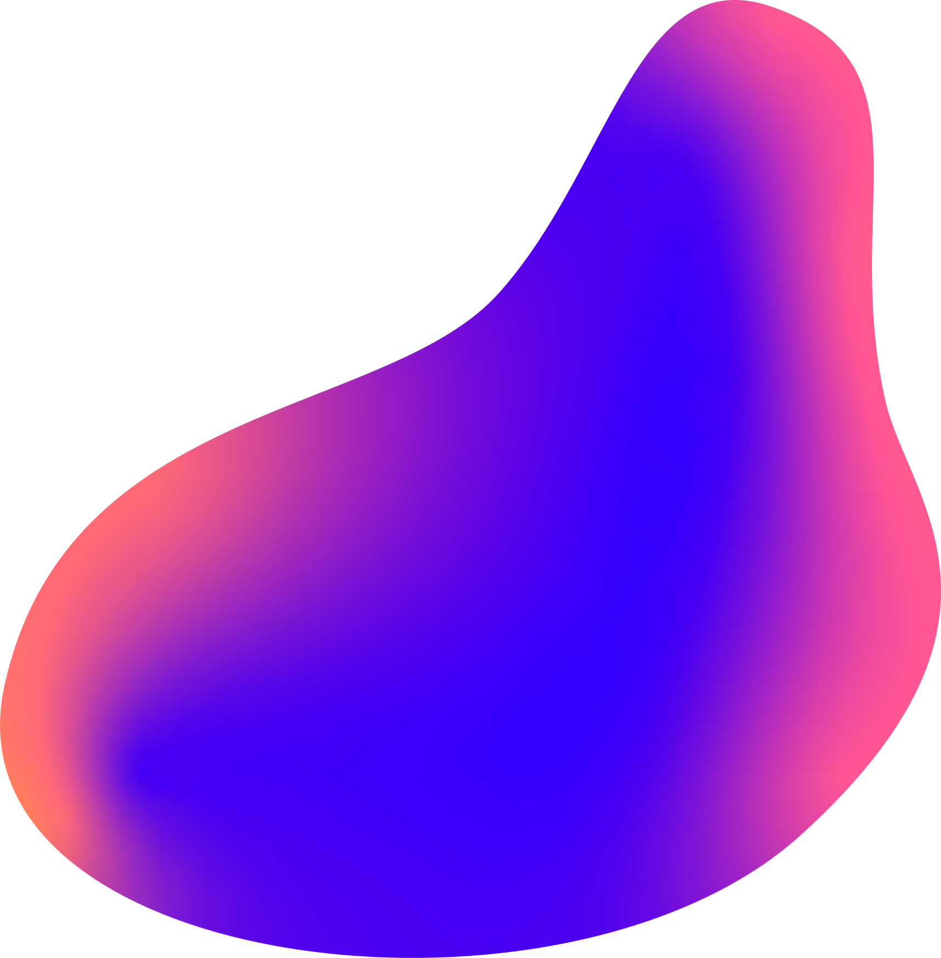
Project Goals
1.
Designed OmniDetect to make object-detection accessible to:
Non-Technical users (no coding required)
Small businesses (no cloud or GPU costs)
Educators and students( hands-on learning tool)
2.
Real- time performance (30+ FPS):
Live decision-making
matches human speed (smooth motion)
3.
Multi-format support::
Covers 95% of visual data

Slide 4
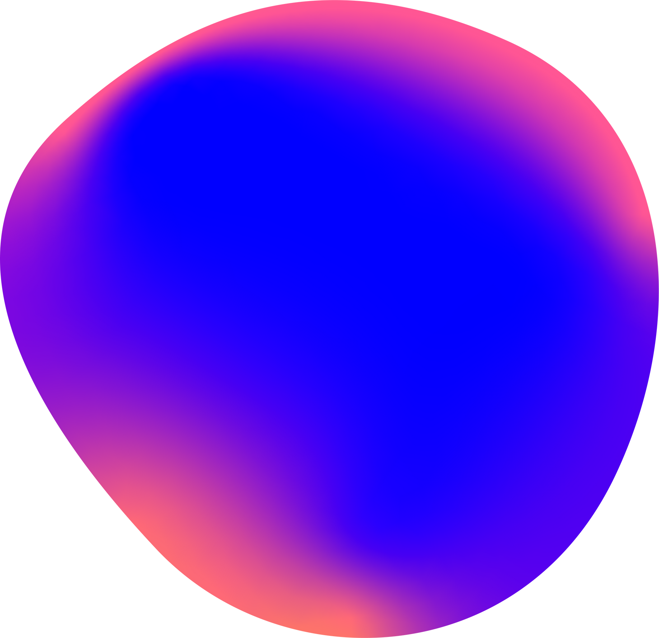





Frontend:
Streamlit
Backend:
Python + OpenCV
Tech
Stack
AI Model:
YOLOV8 (Ultralytics)

Slide 5
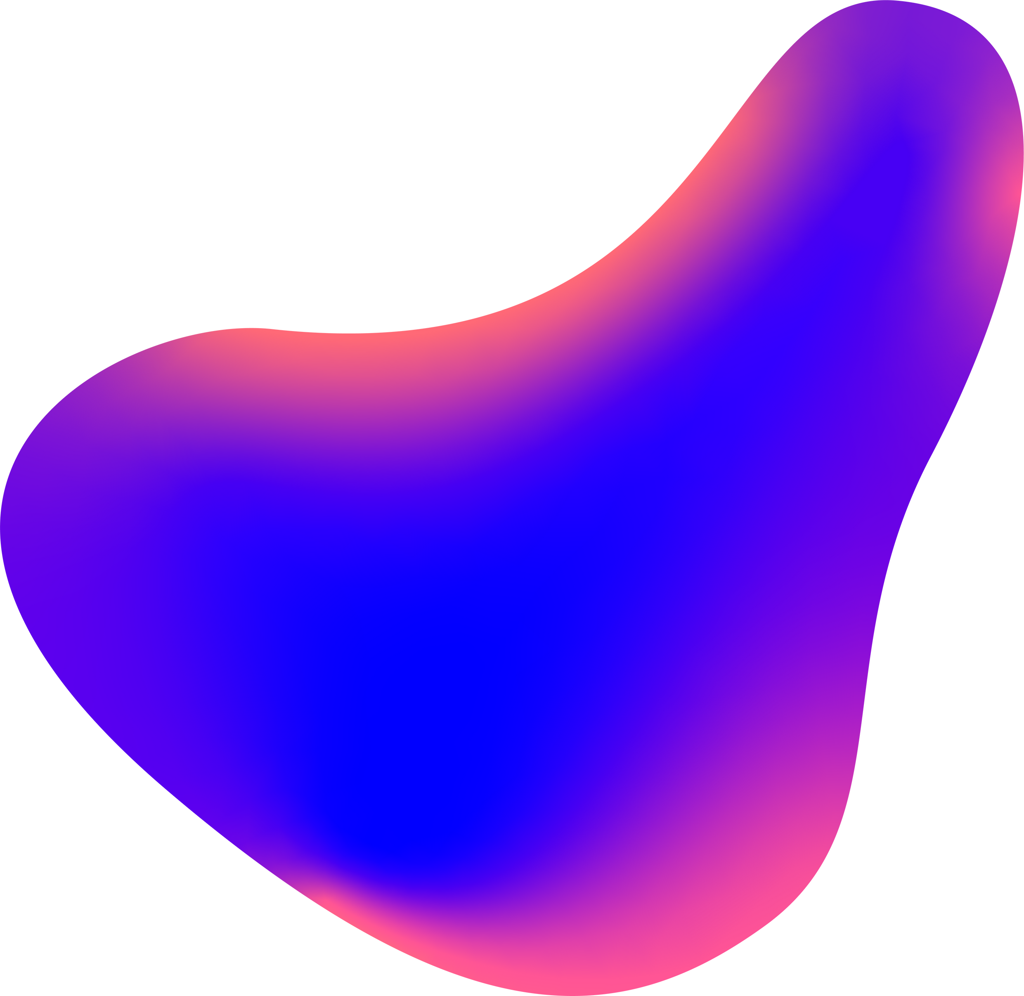
01
YOLO
YOLO (You Only Look Once) revolutionized object detection by introducing a single-stage, real-time deep learning approach. Unlike traditional methods that required multiple passes over an image like R-CNN. YOLO processes the entire image in one forward pass of a neural network, making it significantly faster while maintaining strong accuracy.

Slide 6
Advantages of YOLO
Very fast image procession: milliseconds to produce 30+ FPS
Real-time performance: enables live applications like drones and surveillance
High accuracy with efficiency: Uses anchor-free detection ( prediction key properties like center and corner points)
02

Slide 7

Results: Before

Slide 8
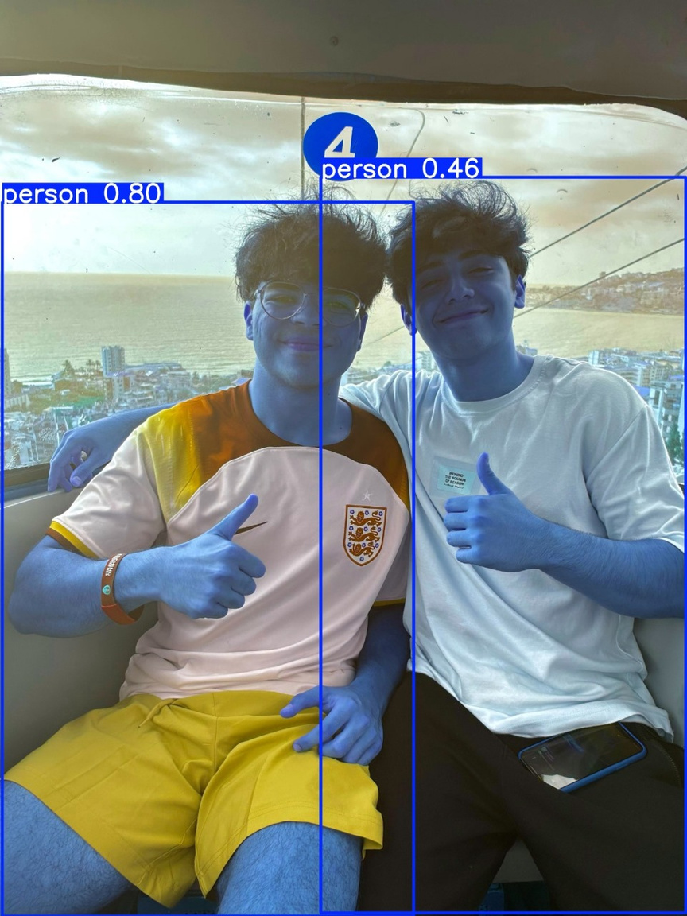
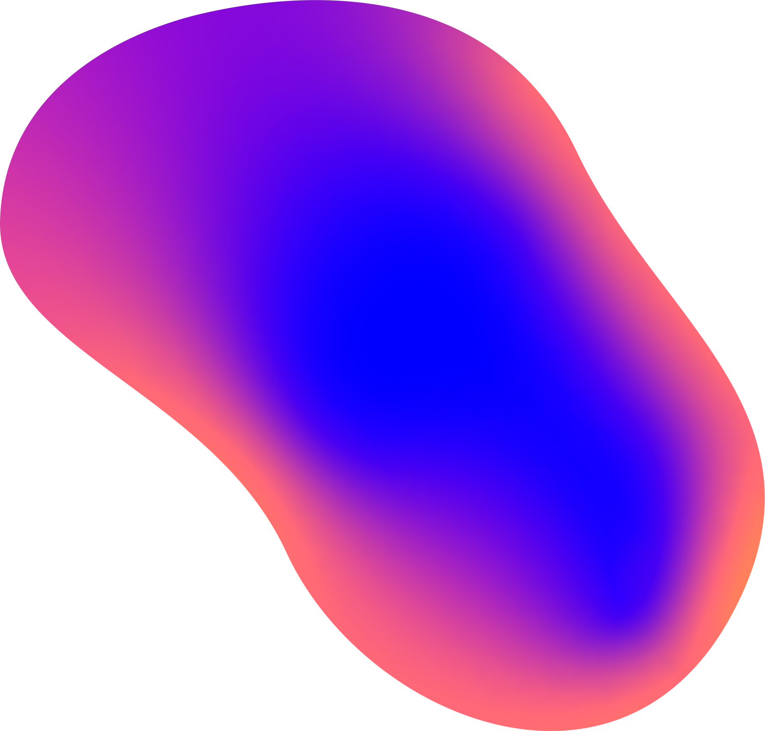
Results: After

Slide 9
Conclusion
Proven Vesratility
Modular and Scalable
Real-Time Performance
Democratized AI Vision
Validated across images, videos, and potential webcam feeds—ready for industry adoption.
Designed for easy customization (swap models, add sensors) and deployment (Docker, cloud, edge).
Achieved 30-60 FPS with YOLOv8, enabling live use cases (for security purposes)
Made cutting-edge object detection accessible to non-experts via an intuitive Streamlit interface.

